Slide 1
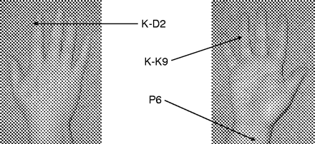
Perioperative Prevention of PONV in Paediatric Patients
Low Risk
No prophylaxis
Moderate Risk (<3RF)
Ondansetron 0.1-0.15mg/kg (maximum 4mg) or
Minimise fasting time
IV fluids – ensure hydration in theatre
Consider non-pharmacological therapy e.g. anxiety management, acupuncture
High Risk (>3RF / Surgical Factor)
Ondansetron 0.1-0.15mg/kg and
Dexamethasone 0.1-0.15mg/kg
Dexamethasone 0.1-0.15mg/kg
Consider TIVA
Opioid sparing techniques e.g. regional
Minimise fasting time
Consider non-pharmacological therapy e.g. anxiety management, acupuncture
IV fluids – ensure hydration in theatre
and/or:
Treatment of Established PONV in Paediatric Patients
When Other Causes Excluded
Child received intra-op anti-emetic?
Ondansetron 0.1 - 0.15mg/kg
Already received Ondansetron
Give 2nd anti-emetic from another class
E.g.: Dexamethasone 0.1-0.15mg/kg , consider Cyclizine 1mg/kg (max 50mg) especially in adolescents.
In all patients, consider:
IV fluids
Regular antiemetic
Discuss with Consultant Paediatric Anaesthetist / pain team
Reducing / stopping opioid background infusion
NO
YES
Risk Factors (RF) for PONV
Non-Pharmacological Therapy
Patient Factors
>3 years old
Hx of motion sickness
Surgical Factors
Strabismus surgery (High risk)
Anaesthetic Factors
Volatile anaesthesia, N20
Hx of PONV
Post-pubertal girls
Tonsil +/- adenoidectomy (High risk)
Middle ear surgery
Post-op opiates
Surgery > 30min
Anticholinesterase
Forced post-op oral fluids
Stimulation of P6 Acupuncture Point
Acupressure wristband (not available in hospital but can be obtained from local pharmacy)
Korean Hand Acupressure
K-D2 point
K-K9 point
By Dr Kim Ng 2011; Updated 2017 C Stannard and L Ikotseroglou ; Approved by Paediatric Pain Team, September 2017; Updated H Lewis 2022
Further Reading: Morrison C and Wilmshurst S. BJA Education, 2019; 19(10): 329-333. APAGBI. Guidelines on the Prevention of PONV in Children. 2016.

